Slide 2
main scientific research areas

Slide 3
main scientific research areas
The education process involves three cycles or degrees in full-time and part-time modes according to the Bologna Declaration directive. To meet the expectations of both our students and modern labor market BUT offers 27 first and 19 second degree courses. Additionally, the graduates as well as other people wishing to continue their education will find a rich variety of postgraduate courses.
Bialystok University of Technology has full rights to confer doctoral (PhD) degrees in ten scientific disciplines, i.e. architecture and urban planning, biocybernetics and biomedical engineering, civil engineering, computer science, electronics, electrical engineering, environmental engineering, environmental protection and development, machine design and maintenance, mechanics. Furthermore, BUT has been granted permission to confer post-doctoral (DSc) degrees in five scientific disciplines, such as civil engineering, electrical engineering, environmental engineering, machine design and maintenance, mechanics.

Slide 4
Faculty of Architecture
MAIN RESEARCH AREAS:
1. Modern housing estates – architecture, standards, spatial and design solutions in housing environment of urban and suburban areas in terms of sustainable development paradigms
2. Transformations of functional and spatial forms and structures in architecture of local borderline cultures. Recording, reconstruction and regeneration
3. Problems of modern architecture
4. Structure and landscape transformations in towns and villages of north-eastern Poland
5. Creating space in natural environment of humans
6. Architecture in the face of historical challenges – selected issues of 20th-century Polish architecture from cultural, social and anthropological perspectives
7. Time – the own space
rights to confer scientific degrees:
doctoral degree in in the field of :
Architecture and Urban Planning
employed 31 doctors and 16 professors

Slide 5
Faculty of Civil and Environmental Egineering
MAIN RESEARCH AREAS:
1. Biochemical and physico-chemical analysis and evaluation of possibilities of biodegradation of selected phenolic compounds. Searching for new applications of researched compounds in environmental engineering and environment protection
2. Experimental and theoretical modelling of non-linear characteristics of building structures behaviour
3. Forming the properties of building materials
4. Analysis of the influence of physico-technical, climatic and economic factors on optimal solutions concerning energy-efficient buildings
5. Analysing selected problems in spatial management and engineering
6. Podlasie landscape identity
7. Efficient methods and algorithms in numerical analysis of building structures, including feasibility, design, implementation and exploitation phases
8. Physical and mechanical parameters in terms of soil modelling and incorporating soils into earth structures
rights to confer scientific degrees:
doctoral degree in civil engineering, environmental engineering, environmental protection and development
post-doctoral degree in civil engineering and environmental engineering
employed 99 doctors and 40 professors

Slide 6
Faculty of Civil and Environmental Engineering
MAIN RESEARCH AREAS cont.:
9. Reactions of wetland ecosystem habitats and plants to active protection measures
10. Modern technical and technological solutions in water supply and sewage systems and waste management systems
11. Advanced technologies in water protection and treatment and in waste neutralisation
12. Research on and simulation of energy-efficient heating and ventilation systems as well as areas of human presence
13. Shaping road infrastructure elements in terms of their durability, traffic safety, environment protection and construction costs
14. Innovative technologies in compaction, combustion, gasification and processing of agri-food materials
15. Analysis of the influence of beneficial and harmful microorganisms on the natural environment
rights to confer scientific degrees:
doctoral degree in civil engineering, environmental engineering, environmental protection and development
post-doctoral degree in civil engineering and environmental engineering
employed 99 doctors and 40 professors

Slide 7
Faculty of Electrical Engineering
MAIN RESEARCH AREAS:
1. Modern methods of analysis, synthesis, control and diagnostics of dynamic systems
2. Selected mathematical and experimental methods applied for analysing electrical and thermal phenomena
3. Power electronics systems in propulsion applications, renewable energy sources and renewable energy sources conditioning systems
4. Technologies of active optical fibres and semi-conductive radiation sources application
5. Research on and designing of teleinformatic devices and systems in terms of electromagnetic compatibility
rights to confer scientific degrees:
doctoral degree in electrical engineering and electronics
post-doctoral degree in electrical engineering
employed 52 doctors and 19 professors

Slide 8
Faculty of Computer Science
MAIN RESEARCH AREAS:
1. Selected problems of theoretical and applied mathematics
2. Data representation and processing methods in multimedia systems
3. Methods of exploration and modelling of multi-dimensional data sets
4. Intelligent systems
5. Selected issues of pure and applied mathematics using information technology tools
rights to confer scientific degrees:
doctoral degree in computer science
employed 48 doctors and 19 professors

Slide 9
Faculty of Mechanical Engineering
MAIN RESEARCH AREAS:
1. Research on components and algorithms for intelligent technical systems
2. Issues in mechanics of heterogeneous and anisotropic materials
3. Analysis of durability and reliability of mechanical structures in their operation processes
4. Research on heat and flow processes in stream systems and densely packed developed surfaces
5. Development of biomaterials, biomedical constructions and computer-aided methods in medicine
6. Manufacturing technologies and qualitative studies of spatial objects shaped with subtractive and additive methods
rights to confer scientific degrees:
- doctoral degree in machine design and maintenance, mechanics, biocybernetics and biomedical engineering, automatic control and robotics (from 2017)
post-doctoral degree in machine design
and maintenance and mechanics
employed 57 doctors and 32 professors

Slide 10
Faculty of Management
MAIN RESEARCH AREAS:
1. Entrepreneurship – Cooperation – Cross-borderness
2. Modern methods of manufacturing and logistics management
3. Technical, economic and environmental aspects of innovations in industry
4. Asset and liability management in business entities and public sector entities
5. Methods of solving modern problems in organisation management
6. Management of regional and local development
7. New trends in tourism management in the region
employed 74doctors and 27 professors

Slide 11
Faculty of Forestry in Hajnówka
MAIN RESEARCH AREAS:
1. Identification of secondary metabolites in vascular plants and fungi found in Bialowieza Primaeval Forest
employed 9 doctors and 5 professors

Slide 12
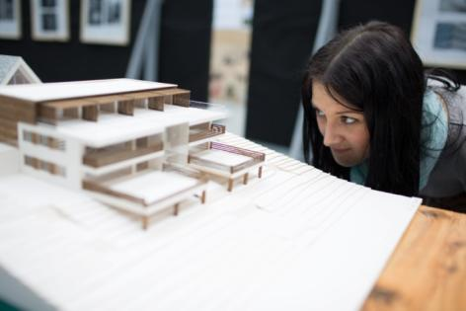
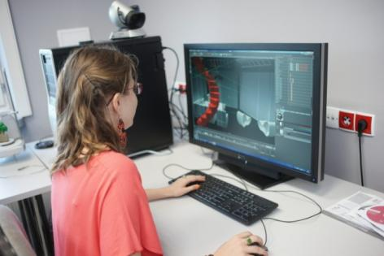
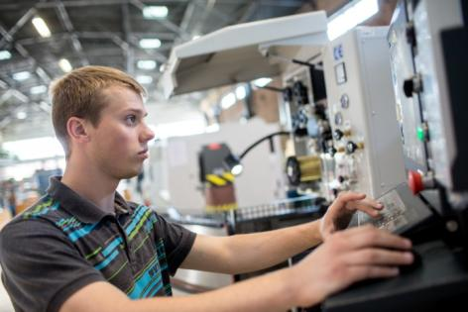
scientific schools
top research areas

Slide 13
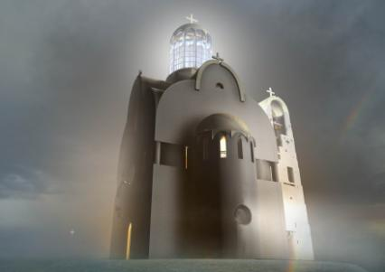
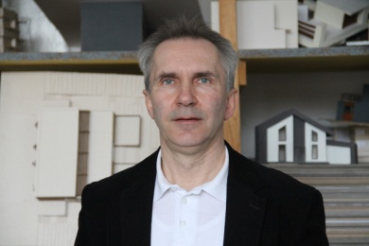
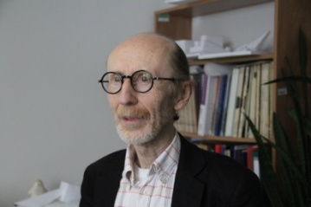
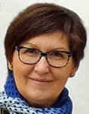
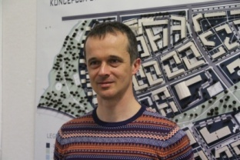
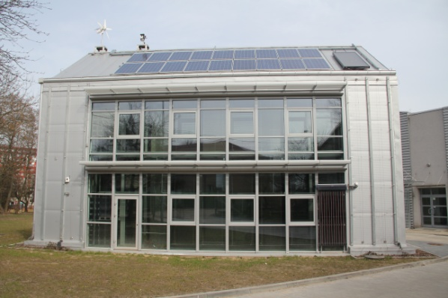
top research areas
Faculty of Architecture
Cultural heritage, churches and other places of worship
Andrzej Tokajuk, PhD. Eng. Arch. tokajuk@pb.edu.pl
Habitat 21
Architecture
Urban Concepts
Sustainability
Assoc. Prof. Jerzy Uścinowicz, DSc. Eng. Arch.
jus@pb.edu.pl
ICT technologies
CAD
3D Scanning
History of architecture of
north-eastern Poland and Eastern Borderlands
Aleksander Asanowicz, DSc. PhD. Eng. Arch. a.asanowicz@pb.edu.pl
Małgorzata Dolistowska, DSc. PhD. m.dolistowska@pb.edu.pl
Natural Materials
Sustainable Building Technologies
Jarosław Szewczyk, DSc. PhD. Eng. Arch.
j.szewczyk@pb.edu.pl
Renewable Energy Lab

Slide 14
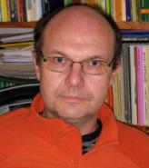
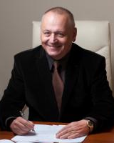
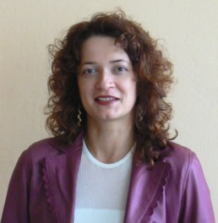
top research areas
Faculty of Civil and Environmental Engineering
modelling and optimisation of water purification, sewage treatment, and sewage sludge processing
renewable energy use
Assoc. Prof. Piotr Banaszuk, DSc. PhD. p.banaszuk@pb.edu.pl
Prof. Lech Dzienis, DSc. PhD. Eng.
rektor@pb.edu.pl
concrete structures with non-metallic reinforcement, hybrid engineering and civil engineering structures
in cooperation with the German Biomass Research Centre [DBFZ] in Leipzig
Assoc. Prof. Marta Kosior-Kazberuk,
DSc. PhD. Eng.
m.kosior@pb.edu.pl

Slide 15
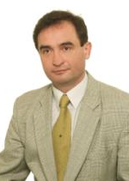
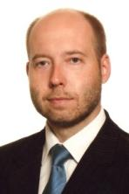
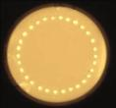
top research areas
Faculty of Electrical Engineering
automatic control and control theory
Assoc. Prof. Karol Aniserowicz, DSc. PhD. Eng. k.aniserowicz@pb.edu.pl
prof. Tadeusz Kaczorek, DSc. PhD. Eng.
t.kaczorek@pb.edu.pl
electromagnetic compatibility
technology of optical fibres and photonic material engineering
renewable energy sources
prof. Andrzej Sikorski, DSc. PhD. Eng. a.sikorski@pb.edu.pl
Assoc. Prof. Dominik Dorosz, DSc. PhD. d.dorosz@pb.edu.pl
new Laboratory of Optical Fibre Technology, proposed for inclusion in the Polish Road Map of Research Infrastructure
scientific cooperation with Wroclaw University of Technology, Military University of Technology, AGH University of Science and Technology, Silesian University of Technology, Warsaw University of Technology, etc.

Slide 16
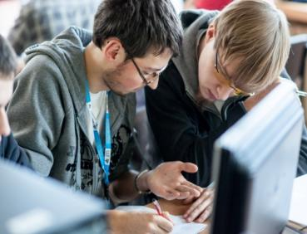
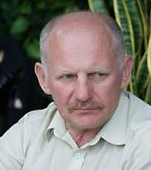
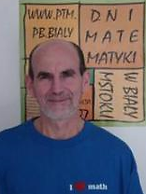
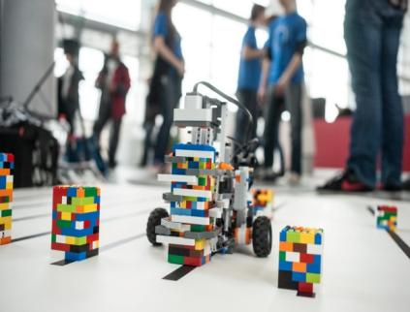
top research areas
Faculty of Computer Science
data mining
prof. Leon Bobrowski, DSc. PhD
wi.dziekan@pb.edu.pl
artificial intelligence
mathematical control theory
prof. Jarosław Stepaniuk, DSc. PhD.
j.stepaniuk@pb.edu.pl
prof. Zbigniew Bartosiewicz, DSc. PhD. Eng.
z.bartosiewicz@pb.edu.pl
algebra
prof. Piotr Grzeszczuk, DSc. PhD.
p.grzeszczuk@pb.edu.pl
biometrics
prof. Khalid Saeed, DSc. PhD. Eng.
k.saeed@pb.edu.pl

Slide 17
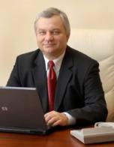
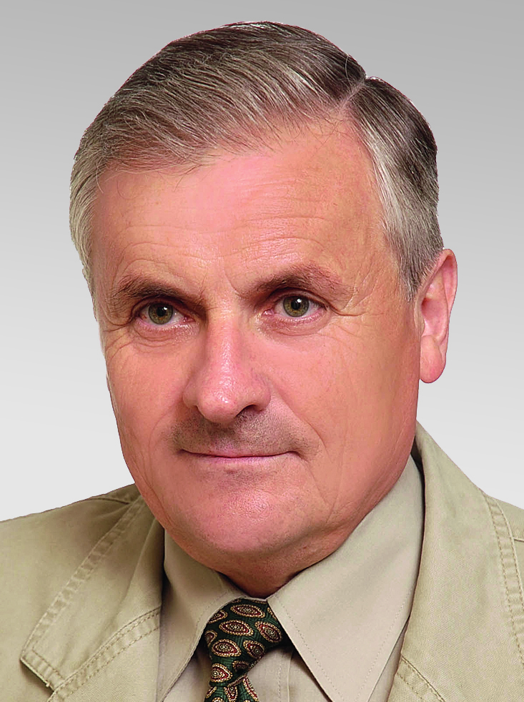
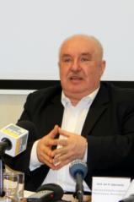
top research areas
Faculty of Mechanical Engineering
mechanics
of modern materials
optimization
of refrigeration
and air conditioning systems operating
with ecological working fluids
prof. Andrzej Seweryn, DSc. PhD. Eng.
a.seweryn@pb.edu.pl
prof. Teodor Skiepko, DSc. PhD. Eng.
t.skiepko@pb.edu.pl
biomedical engineering
prof. Jan R. Dąbrowski, DSc. PhD. Eng.
j.dabrowski@pb.edu.pl

Slide 18
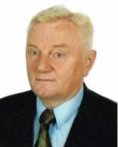
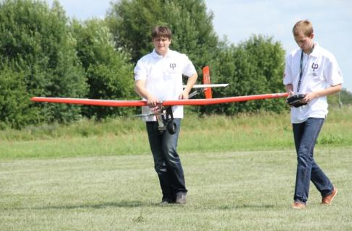
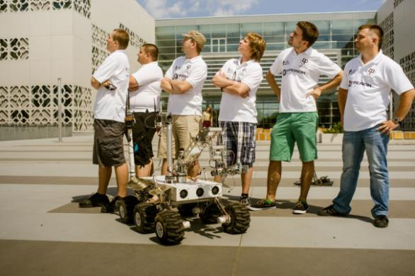
top research areas
autonomous flight control system for unmanned aerial vehicles
Cezary Kownacki, PhD. Eng.
c.kownacki@pb.edu.pl
modeling, control and diagnostics of intelligent technical systems
prof. Zdzisław Gosiewski, DSc. PhD. Eng.
gosiewski@pb.edu.pl
designe
of analogues
of Mars rovers
modeling
and diagnostics methods
of human gait system
Justyna Tołstoj-Sienkiewicz, PhD. Eng.
j.tolstoj-sienkiewicz@pb.edu.pl
Jolanta Pauk, DSc. PhD. Eng.
j.pauk@pb.edu.pl

Slide 19
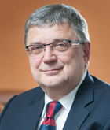
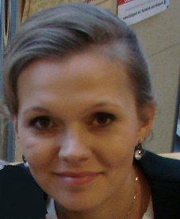
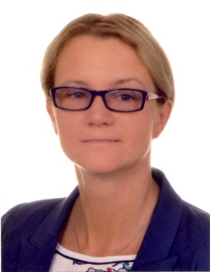
top research areas
Logistic and supply chain management
Urszula Ryciuk, PhD
u.ryciuk@pb.edu.pl
Foresight
study
prof. Joanicjusz Nazarko, DSc. PhD. Eng.
j.nazarko@pb.edu.pl
Faculty
of Management
Chinese-Eastern European logistics
Service engineering
Katarzyna Kuźmicz, PhD
k.kuzmicz@pb.edu.pl
Assoc. Prof. Joanna Ejdys, DSc. PhD. Eng.
j.ejdys@pb.edu.pl

Slide 20
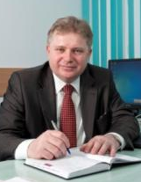
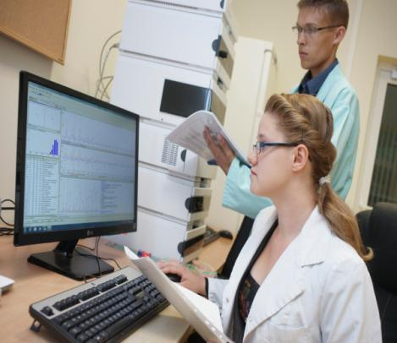
Research Team: prof. Walery Isidorow, DSc. PhD. Ewa Zapora, PhD. e.zapora@pb.edu.pl Małgorzata Rauba, PhD. Eng. m.rauba@pb.edu.pl Halina Chomutowska, PhD. Eng. h.chomutowska@pb.edu.pl Marcin Stocki, MSc. Eng. m.stocki@pb.edu.pl
top research areas
Faculty of Forestry
in Hajnówka
identifying physical and chemical properties of forest materials and products
identification of secondary metabolites in vascular plants and fungi found in Bialowieza Primeval Forest
research on biological activity of plant and fungi extracts
Assoc. Prof. Sławomir Bakier, DSc. PhD. Eng.
s.bakier@pb.edu.pl
analysing physical and chemical properties of surface waters in Bialowieza Primeval Forest
innovative methods of extracting active substances from vascular plants and fungi
Laboratory for Monitoring of Forest Environment
scientific cooperation with University of Mississippi (USA) and New Chemical Syntheses Institute in Pulawy (Poland)

Slide 21
Thank you for your attention
Politechnika Białostocka / Bialystok University of Technology 45 A Wiejska Street 15-351 Białystok, Poland
phone +48 85 746-90-00 to 09/fax. +48 85 746-90-15 website: www.pb.edu.pl e-mail: studyinbut@pb.edu.pl
www.facebook.com/politechnikabialostocka

